Slide 1


TACTICAL COMBAT CASUALTY CARE COURSE
MODULE 19: FRACTURES
Module 19: Fractures
TCCC TIER 1
All Service Members
TCCC TIER 2
Combat Lifesaver
TCCC TIER 3
Combat Medic/Corpsman
TCCC TIER 4
Combat Paramedic/Provider

Slide 2




Module 19: Fractures
TACTICAL COMBAT CASUALTY CARE (TCCC) ROLE-BASED TRAINING SPECTRUM
ROLE 1 CARE
NONMEDICAL PERSONNEL
MEDICAL PERSONNEL
YOU ARE HERE
STANDARDIZED JOINT CURRICULUM
2

Slide 3







Module 19: Fractures
1 x TERMINAL LEARNING OBJECTIVES
22
Given a combat or noncombat scenario, perform assessment and initial treatment of fractures during Tactical Field Care in accordance with CoTCCC Guidelines.
  Identify signs of a suspected fracture.
  Demonstrate the basic care of fractures in accordance with CoTCCC Guidelines.
  Demonstrate proper splint application using a malleable, rigid or improvised splint to a suspected fracture in Tactical Field Care.
03 x ENABLING LEARNING OBJECTIVES
#
= Terminal Learning Objectives
= Cognitive ELOs
= Performance ELOs
3

Slide 4


MARCH PAWS
Module 19: Fractures
LIFE-THREATENING
AFTER LIFE-THREATENING
PAIN ANTIBIOTICS
WOUNDS SPLINTING
M A R C H
P A W
MASSIVE BLEEDING
#1 Priority
AIRWAY
RESPIRATION (Breathing)
CIRCULATION
S
HYPOTHERMIA / HEAD INJURIES
4

Slide 5
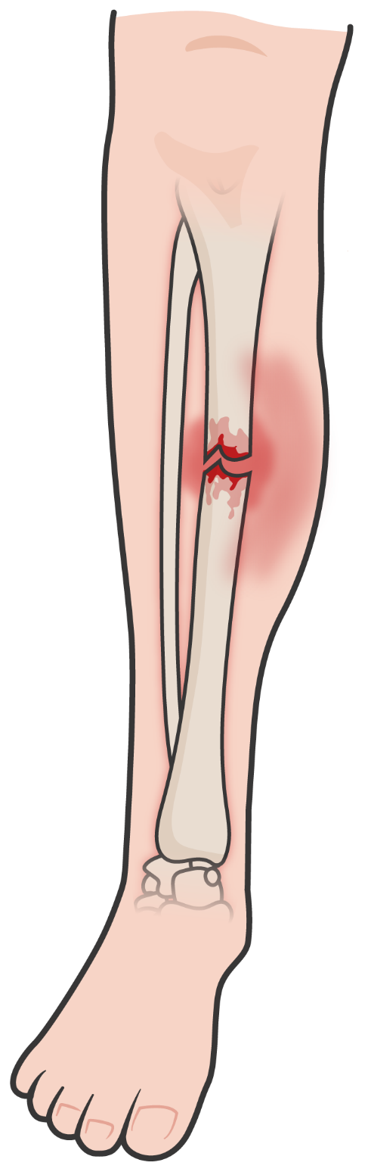
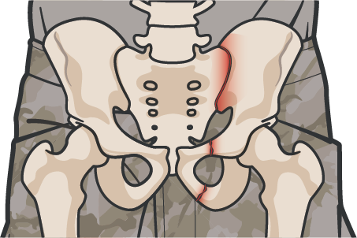

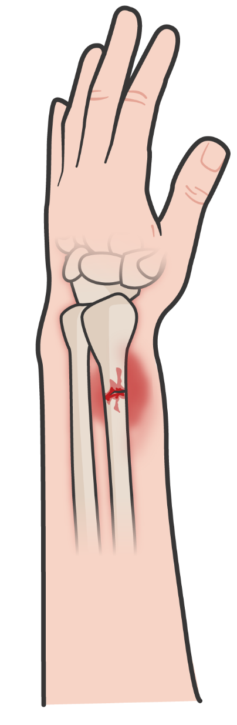
SIGNS OF A SUSPECTED CLOSED FRACTURE
Module 19: Fractures
WARNING SIGNS
OF A CLOSED FRACTURE:
Significant tenderness, pain, and/or marked swelling
Deformity or instability of the bone
An audible or perceived “snap” Hematoma/bruising
Crepitus (crackling/popping under the skin)
Different length or shape of limb
Loss of pulse or sensation distally in the injured arm or leg
A pelvic compression device is indicated in any casualty who suffers severe blunt force or blast injury with symptoms of a pelvic fracture
Splints are not applied to spinal fractures, although the casualty may be immobilized, depending on the tactical situation
P A W
S

Slide 6
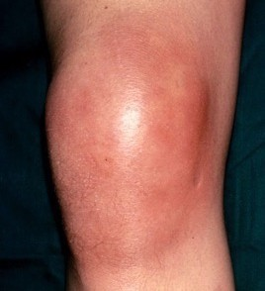
FRACTURES
Module 19: Fractures
CLOSED FRACTURE
Significant blood loss is possible when dealing with Femur Fractures:
No open wound (break in skin)
Risk for tissue damage still significant
Approximate Internal Blood Loss Associated with Fractures
Bone fractured | Internal blood loss *milliliters [ml] per fracture
Rib | 125
Radius or ulna | 250-500
Humerus | 500-700
Tibia or fibula | 500-1,000
Femur | 1,000-2,000
Pelvis | 1,000-massive
Treat all fractures with nearby skin wounds as open fractures (even without bony protrusion or a laceration that doesn’t align)
*(Average total blood volume in an adult = 5,000 to 6,000 ml)
P A W
S

Slide 7
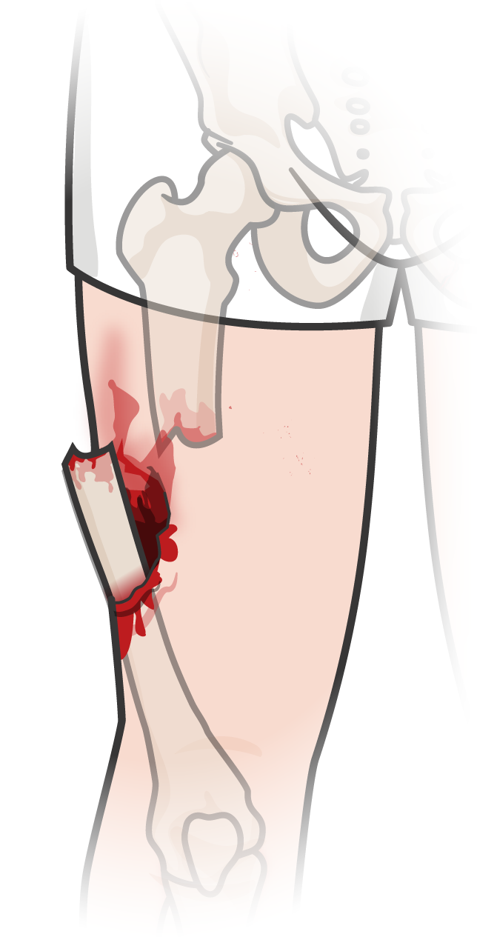
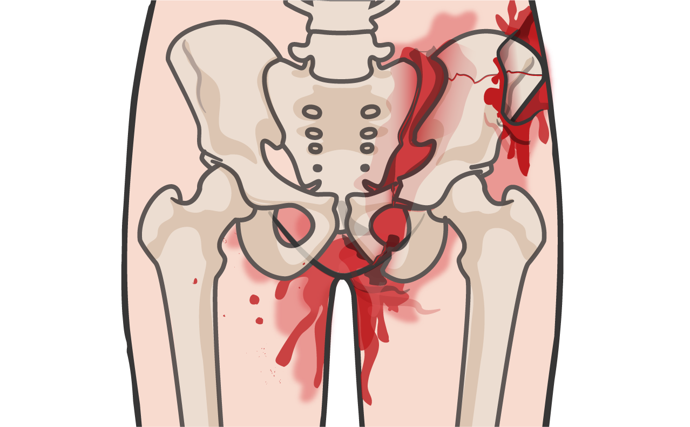
SIGNS OF AN OPEN FRACTURE
Module 19: Fractures
WARNING SIGNS
OF A OPEN FRACTURE:
Significant tenderness, pain, and/or marked swelling
Bone protruding from the wound Open wound near the site Bleeding
Crepitus
Different length or shape of limb
Loss of pulse or sensation distally in the injured arm or leg
Open fracture to the pelvis may lacerate the rectum, perineum, or vagina, and an obvious source of external blood loss may not be readily apparent.
Every effort should be made to control bleeding coming from the site, before any splinting is attempted
P A W
S

Slide 8
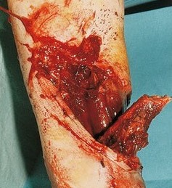
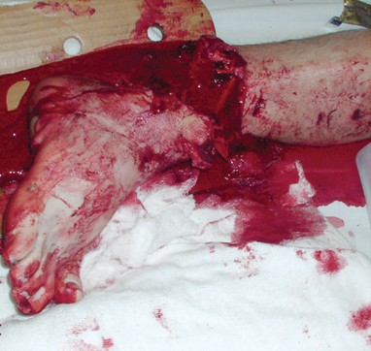
Module 19: Fractures
OPEN FRACTURES (Cont’)
Open wound – associated with an overlying skin wound, significant risk of infection (osteomyelitis)
Open fractures may not always be easy to identify in a trauma patient.
Wound(s) near a possible fracture is considered an open fracture and treated as such
Protruding bone or bone end should not be replaced
Bones occasionally return to a near-normal position when realigned
Ensure that any open injuries are bandaged, and bleeding has been controlled!
P A W
S

Slide 9
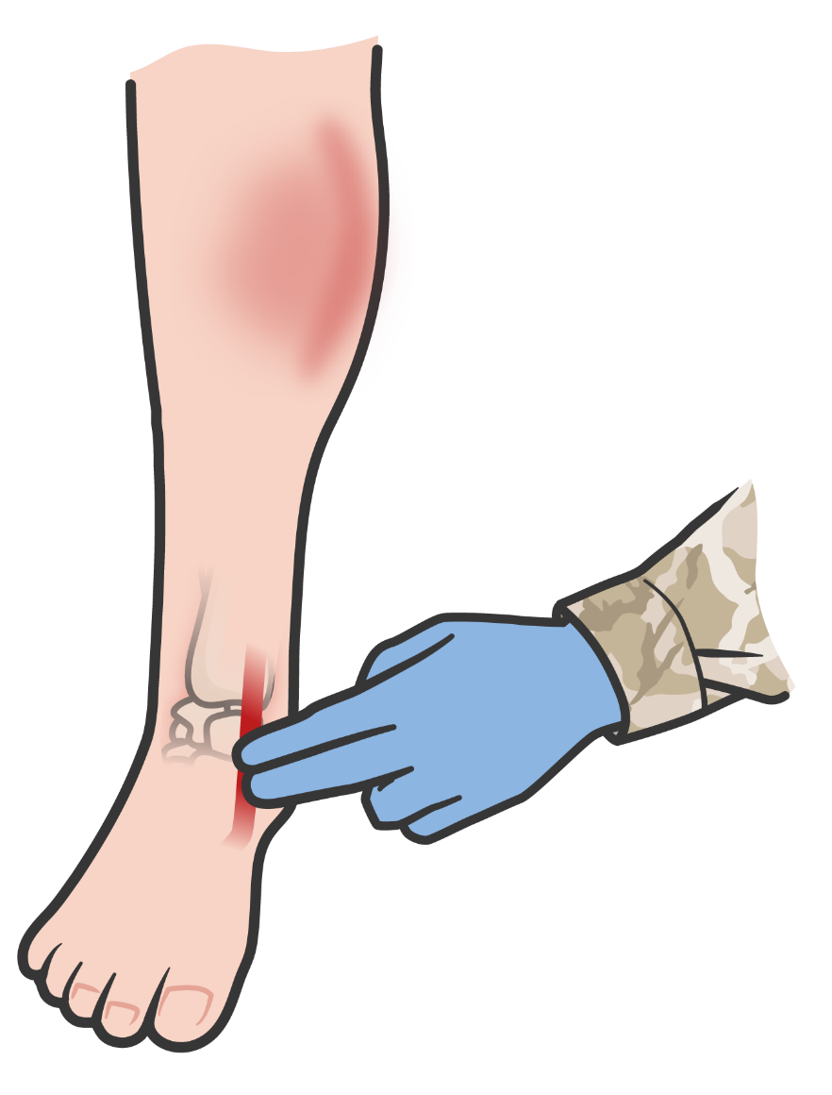
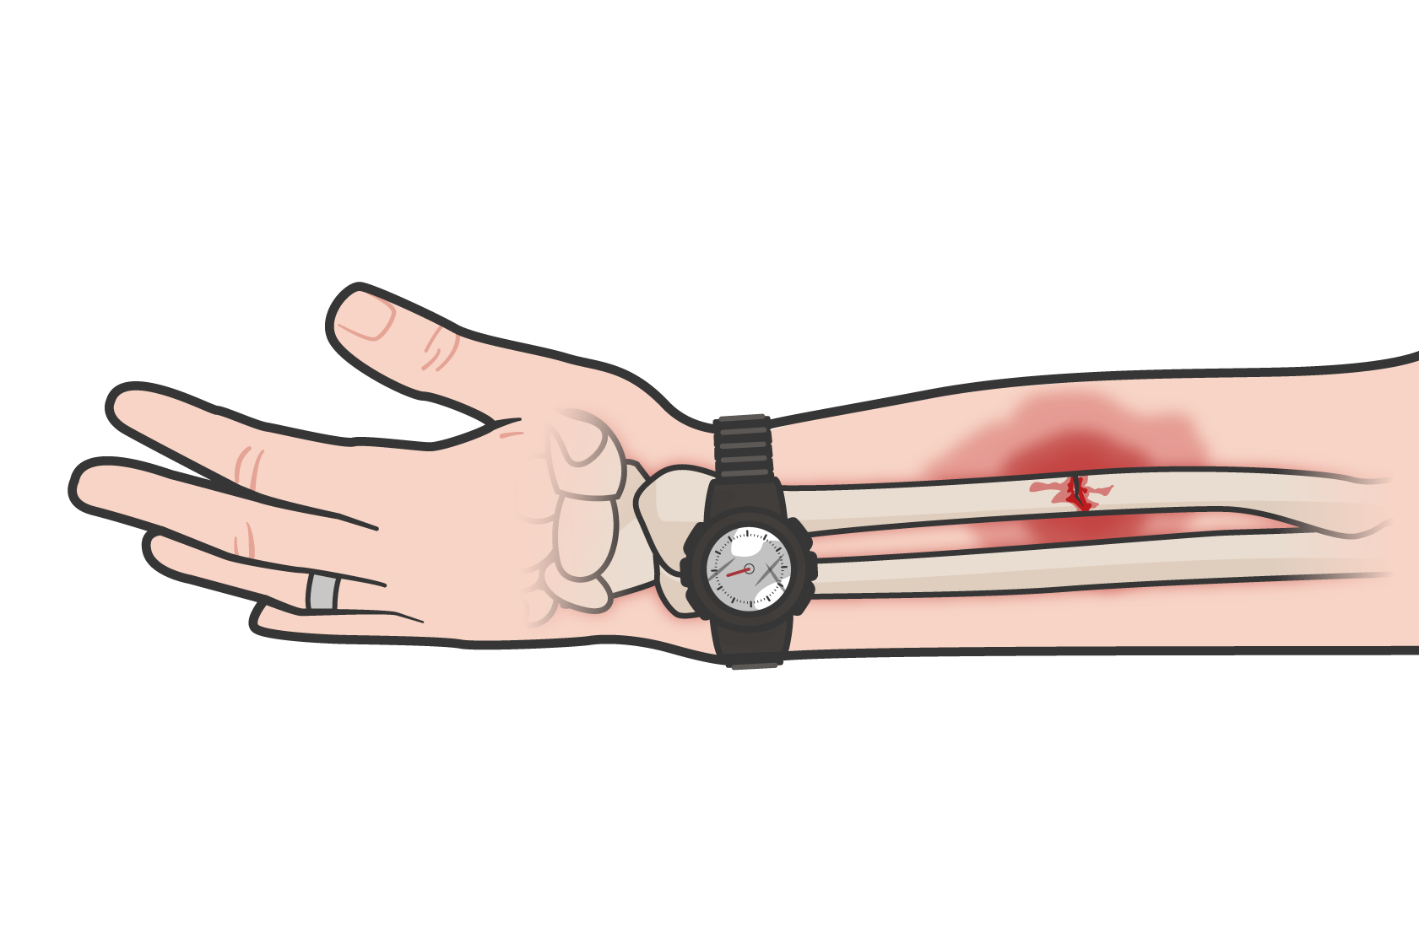
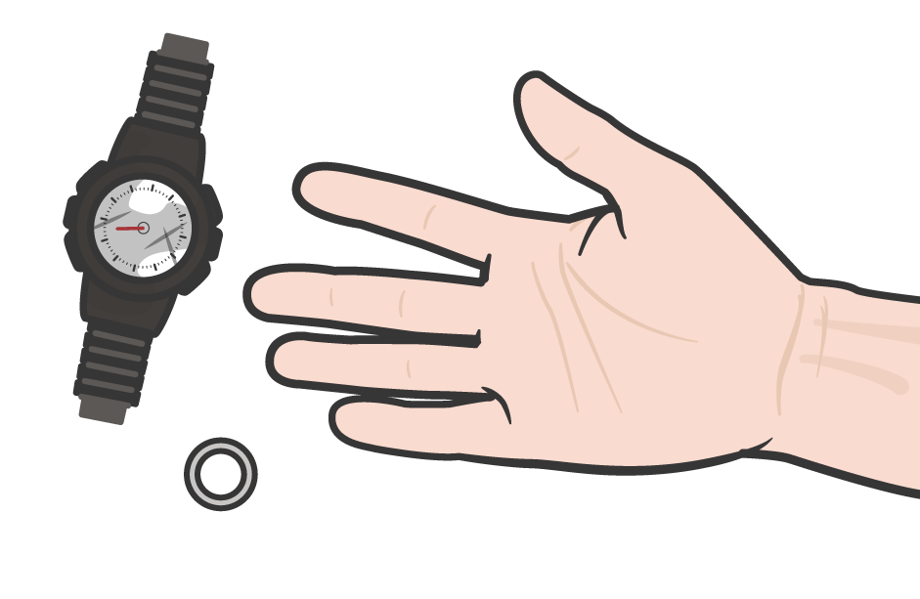
Module 19: Fractures
BASIC MANAGEMENT OF FRACTURES
PRIMARY OBJECTIVES OF FRACTURE TREATMENT:
Identify the location of the fracture and place the extremity in a NEUTRAL POSITION or POSITION of FUNCTION.
CHECK PULSES, skin color, and sensorimotor function distal to the site of the fracture before and after splinting
Prevent further injury Protect nerves
and vessels
Make the casualty more comfortable
REMOVE jewelry, watch, clothing, and/or boots as the situation dictates
REASSESS BLEEDING
control prior to further management of the fracture
P A W
S

Slide 10
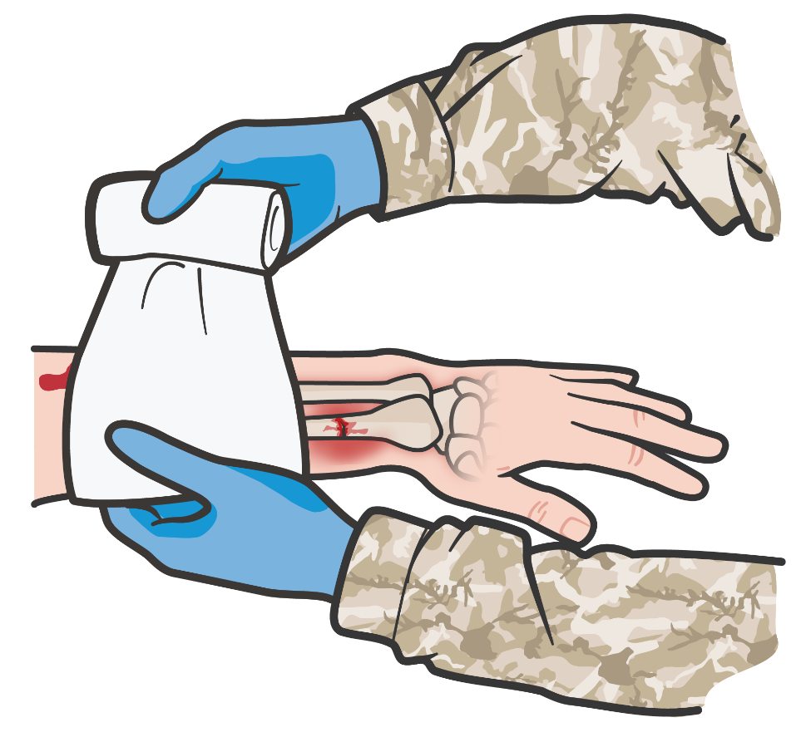
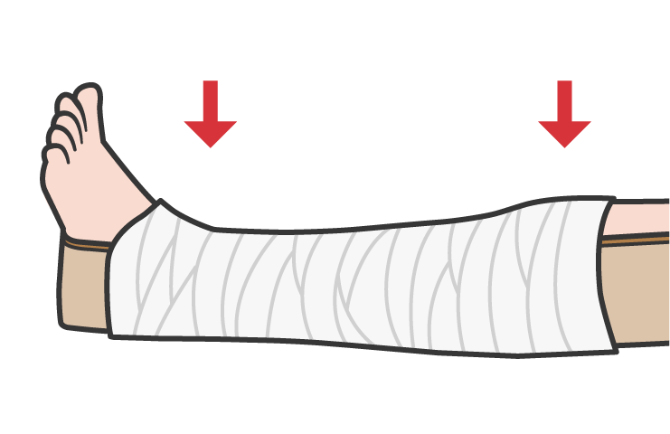
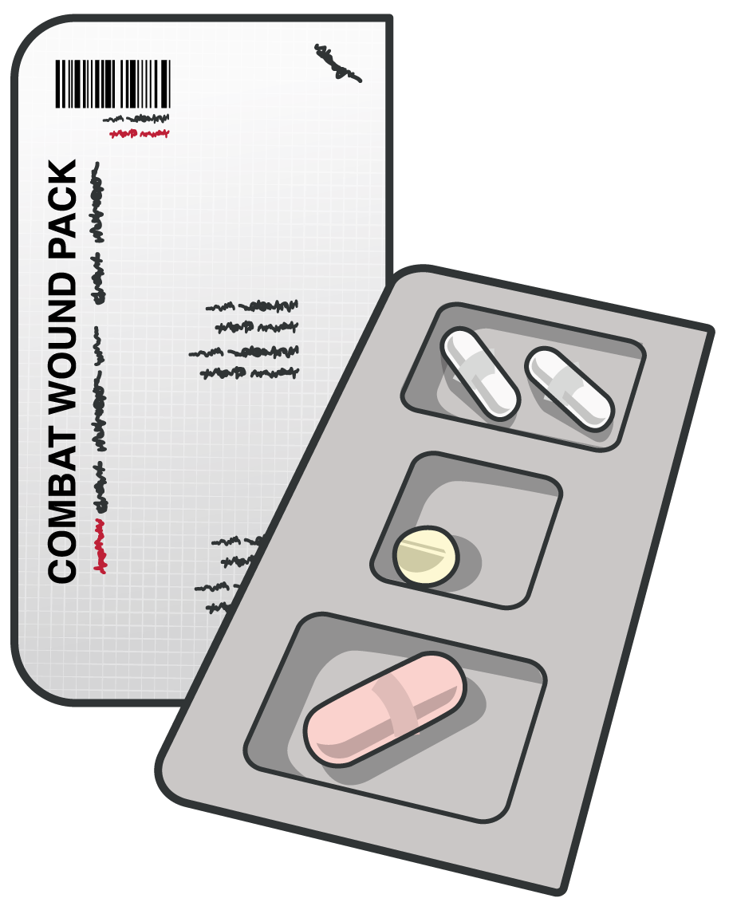
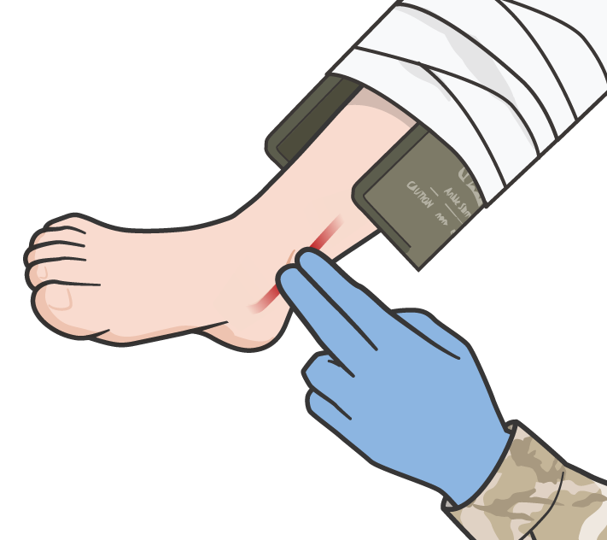
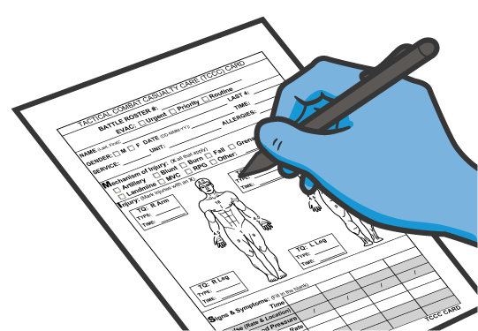
Module 19: Fractures
PRINCIPLES OF FRACTURE MANAGEMENT
DRESS ALL
WOUNDS prior to splint application
Always immobilize the joint proximal and the joint distal to the site of the fracture in your splint
Once you have applied a splint, be sure to reassess the pulses, motor
and sensory (PMS) function
ADMINISTER
pain medications as needed and antibiotics for any open fracture(s)
DOCUMENT all findings and treatments on a DD Form 1380 TCCC
Casualty Card and attach it to the casualty
P A W
S

Slide 11

BASIC SPLINTING PRINCIPLES

Slide 12
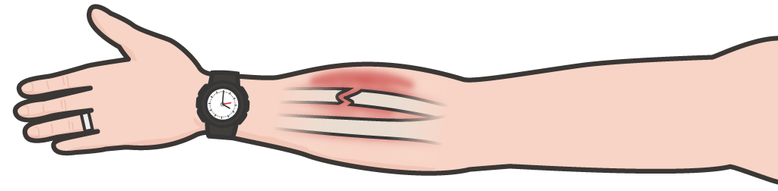
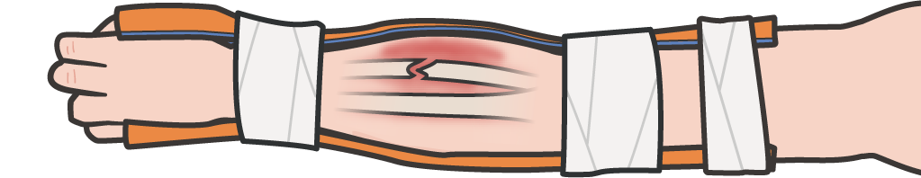
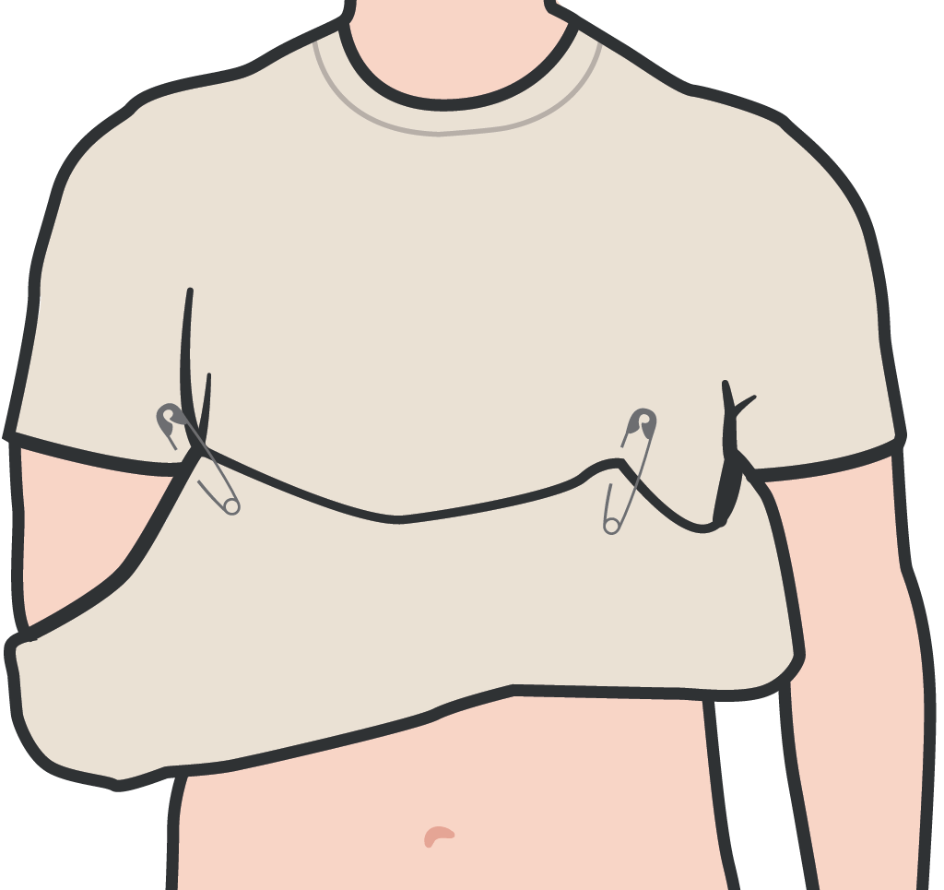
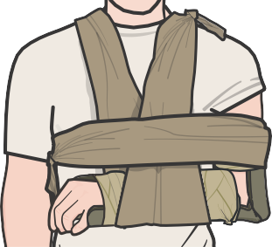
BASIC SPLINTING PRINCIPLES
Module 19: Fractures
Collect materials for splints, padding and securing the splint prior to getting started
Have a Combat Lifesaver assist you, when possible Use the unaffected extremity to mold or design
your splint
Pad all voids to prevent the splint from applying direct pressure to the injured site
Incorporate one joint above and one below the fracture Secure splint with elastic bandage, cravats, tape, etc.
Consider slings and/or swathes, including using the casualty’s shirt or sleeve, if appropriate
Check skin color and PMS before and after splinting
P A W
S
11

Slide 13
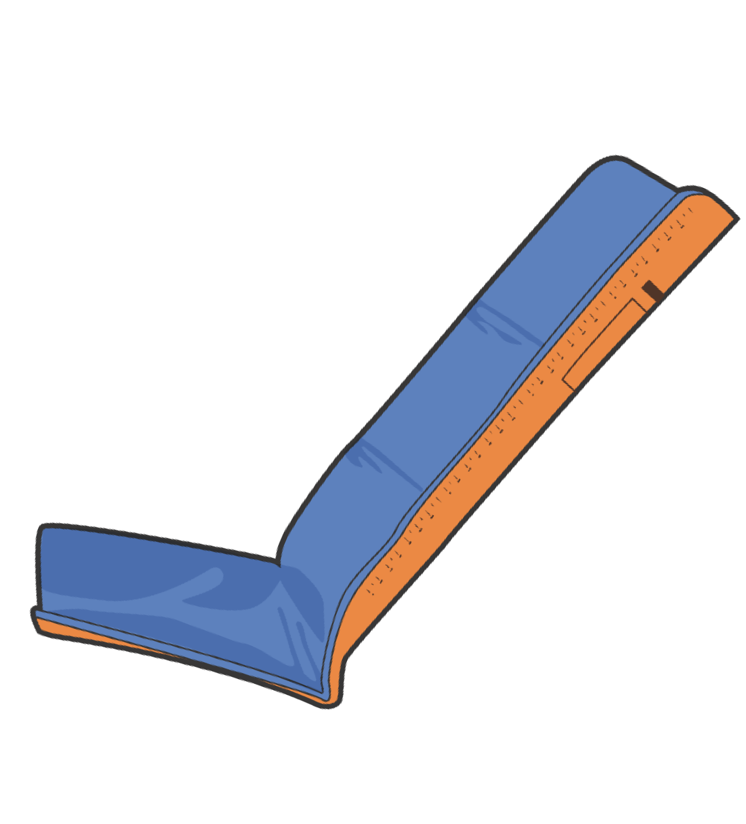
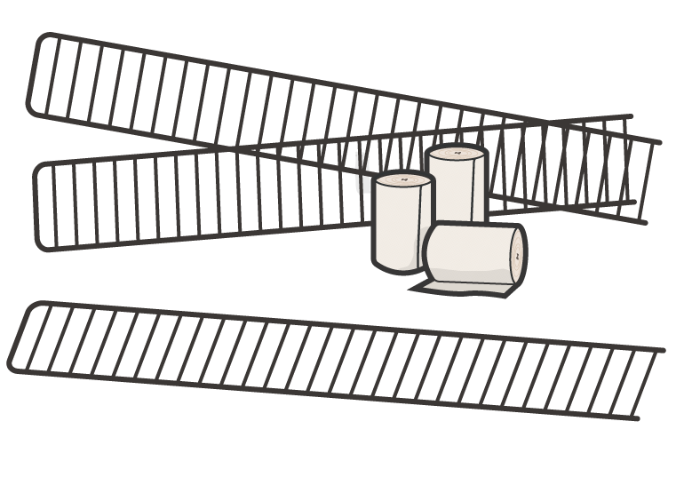
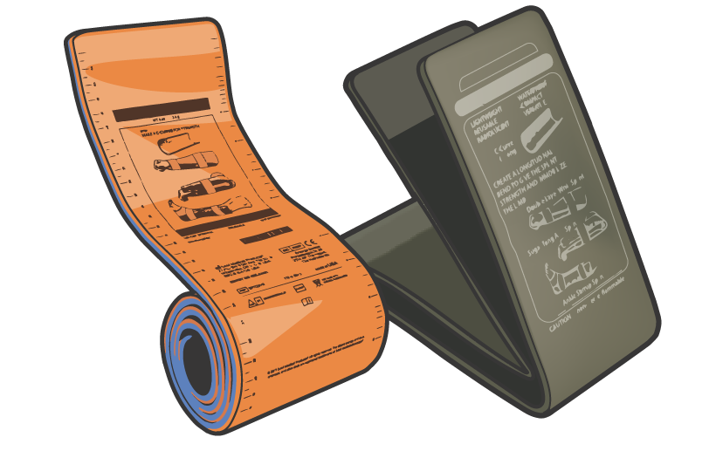
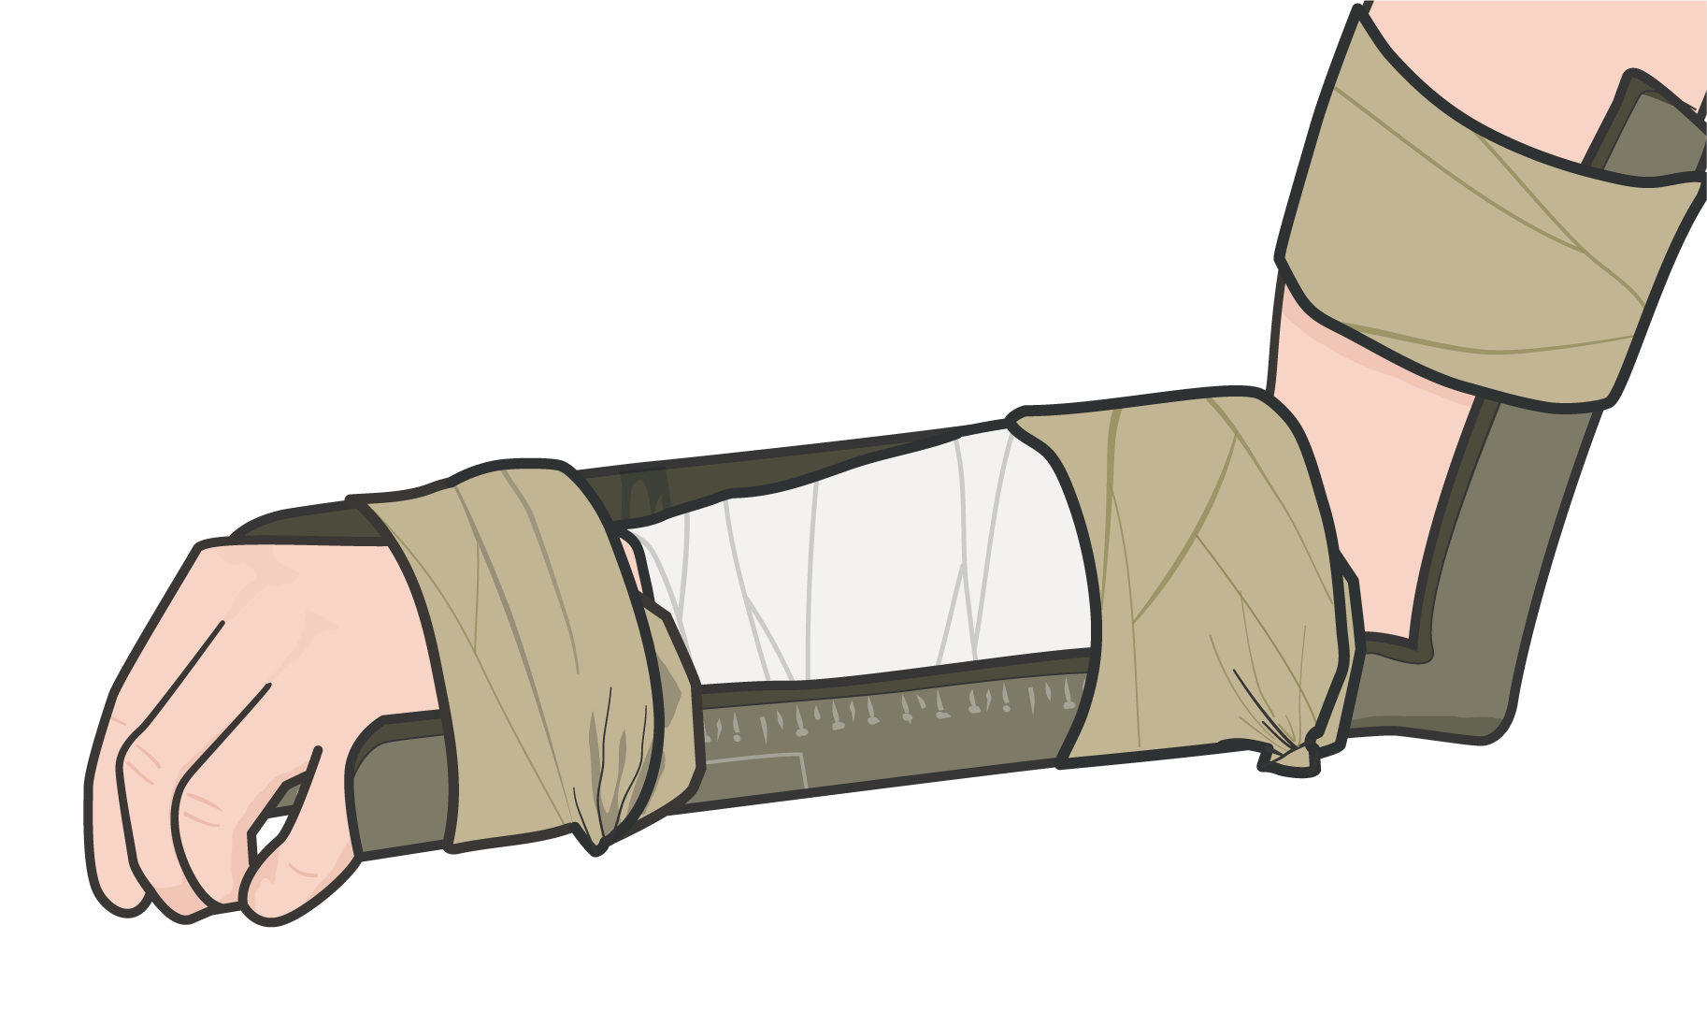
MALLEABLE SPLINTS
Module 19: Fractures
Malleable splints gain rigidity by folding or creasing the metal framework
They can be contoured to the area of injury and molded around joints at angles
using casualty’s unaffected limb
Good for shorter bones and angled splint positions; multiple malleable splints can be combined to support longer bone fractures
Aluminum foam splint
Wire splint
P A W
S

Slide 14
MALLEABLE SPLINTING
Video can be found on deployedmedicine.com

Slide 15
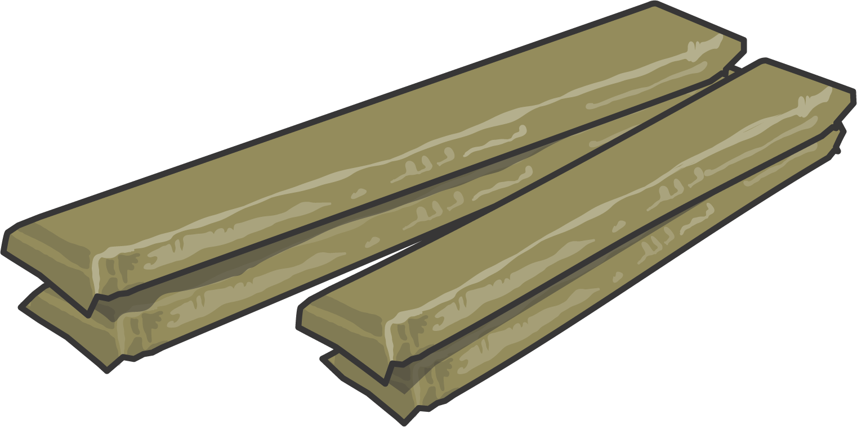
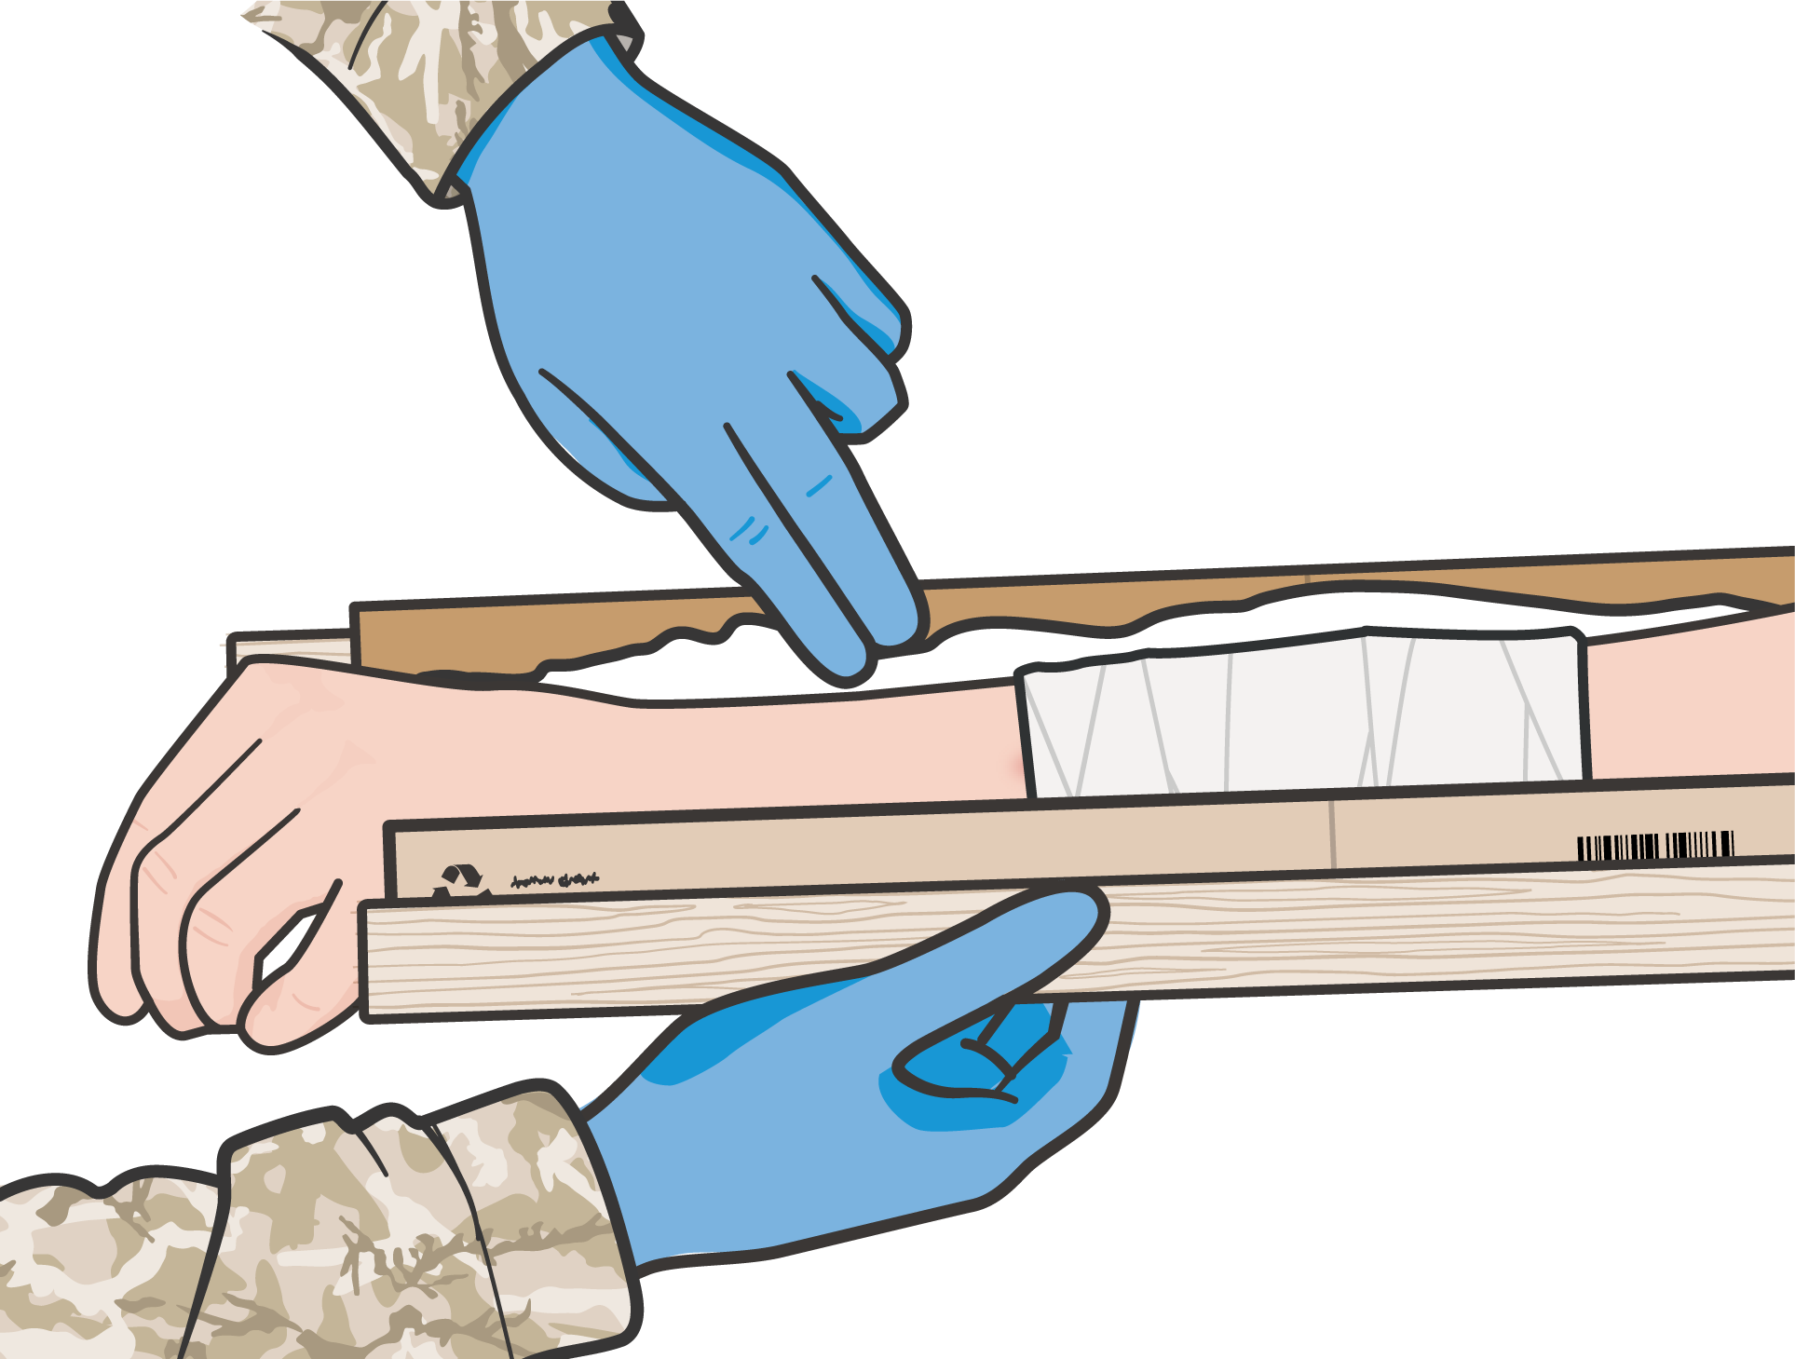
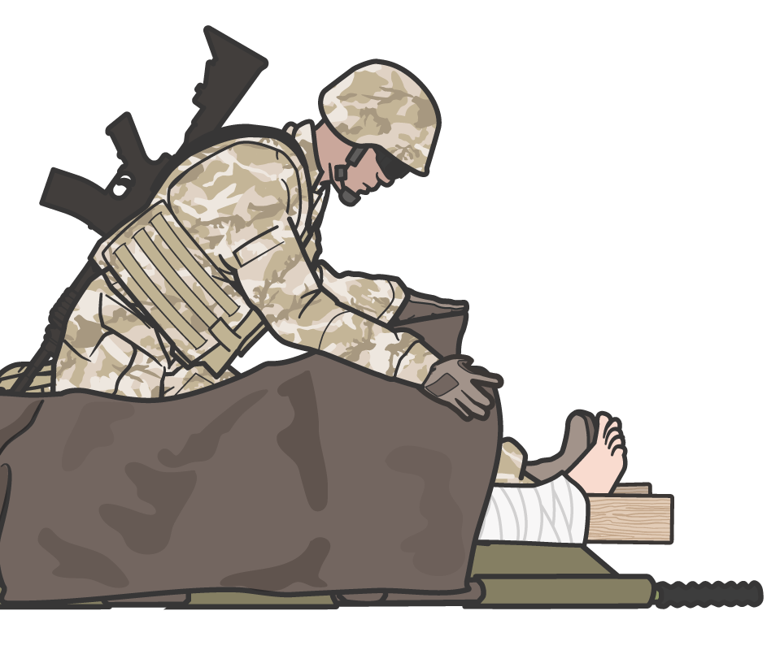
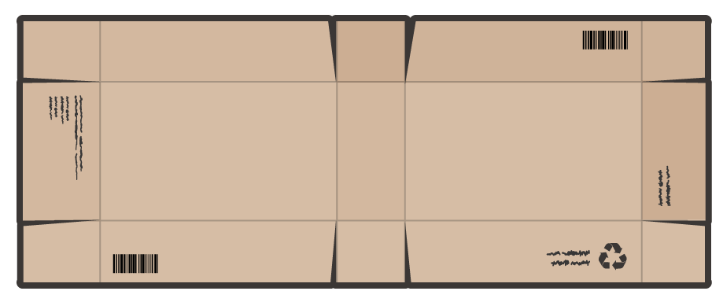
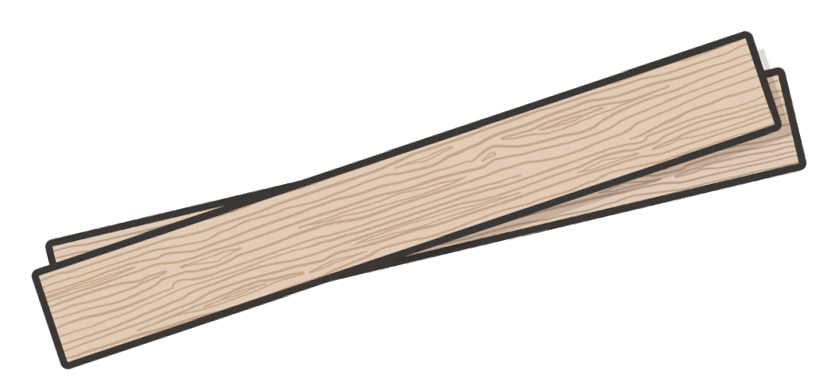
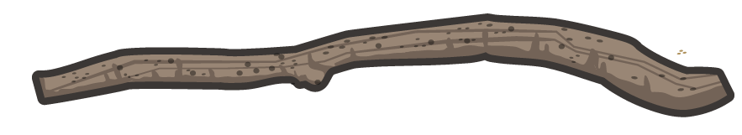
RIGID SPLINTS
Module 19: Fractures
The lack of anatomic contours will usually require more padding
Padded board splints
Often the ends of the splints stick out, creating a hazard during casualty transport
Improvised rigid splint materials
P A W
S

Slide 16
RIGID SPLINTING

Slide 17

THINGS TO AVOID WHEN SPLINTING
Module 19: Fractures
Manipulating the fracture site too much; resulting in pain, additional damage to tissues, blood vessels and nerves
Splinting near or over a wound that has not be properly treated Failing to immobilize joint above and below fracture when possible Securing too tightly, cutting off blood flow
Making casualty uncomfortable during transport/evacuation
P A W
S

Slide 18

SKILL STATION
Module 19: Fractures
Splinting
Splint application using malleable and rigid

Slide 19
SUMMARY
Module 19: Fractures
Identifying the signs and symptoms of fractures
Distinguishing open from closed fractures The basic management of fractures
Splint application using both malleable, rigid, and improvised splints
The most important aspects of splinting are to prevent further injury, splint in a way that does not harm the nerves or blood vessels in the splinted extremity, and minimize the casualty’s pain
P A W
S

Slide 20

CHECK ON LEARNING
Module 19: Fractures
What are the three objectives of fracture management and splinting?
True or False: When applying a splint, ensure the joints above and below the fracture are immobilized in the splint whenever possible.
What should you assess before and after splinting?

Slide 21




Module 19: Fractures
ANY QUESTIONS?

Slide 22
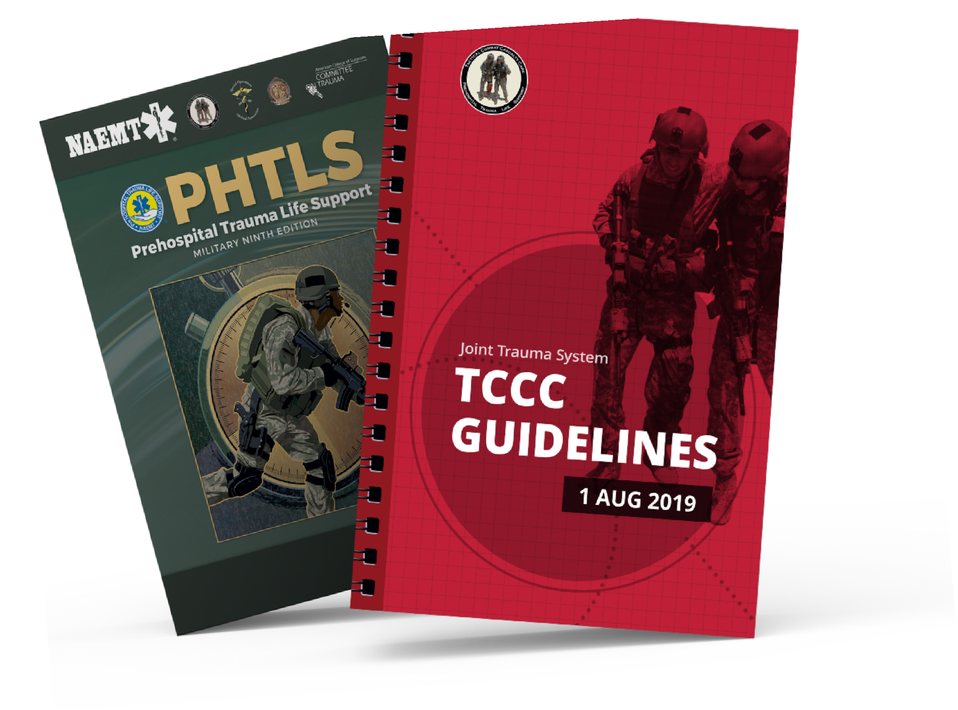
REFERENCES
Module 19: Fractures
TCCC: Guidelines
by JTS/CoTCCC
Updated regularly – latest edition dated 5 November 2020
These guidelines are the result of decisions made by the Committee on Tactical Combat Casualty Care as they explore evidence-based research regarding best practices
PHTLS: Military Edition, Chapter 25
by NAEMT
Prehospital Trauma Life Support, Military Ninth Edition
NOV 2020

